Slide 1
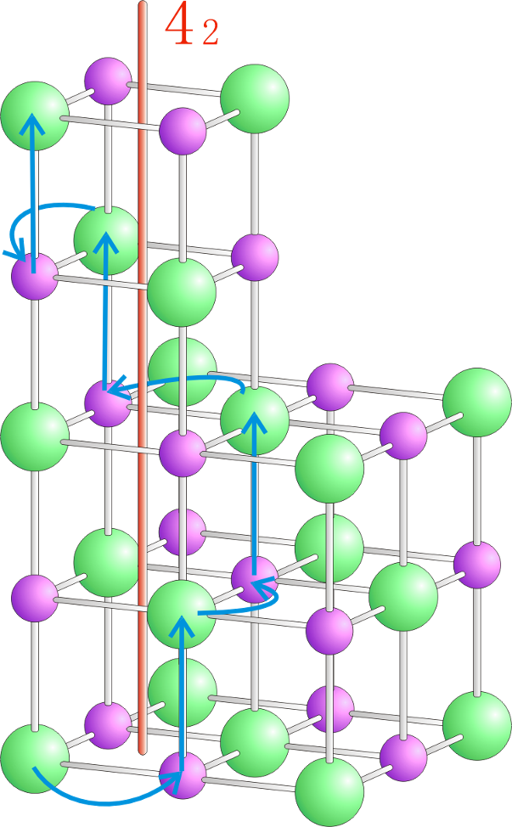
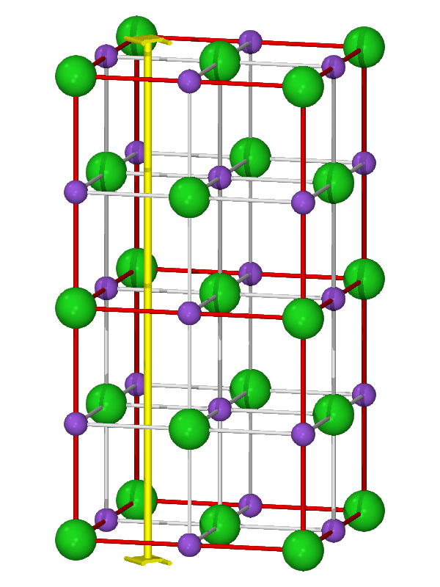
NaCl中的4₂螺旋轴

Slide 2
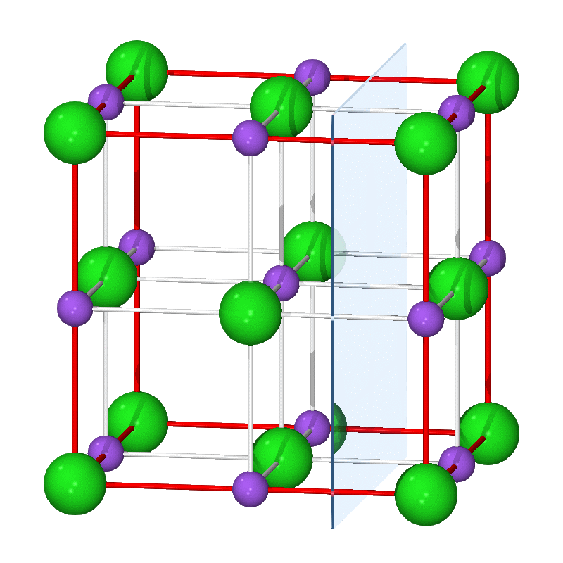
NaCl中的c滑移面

Slide 3
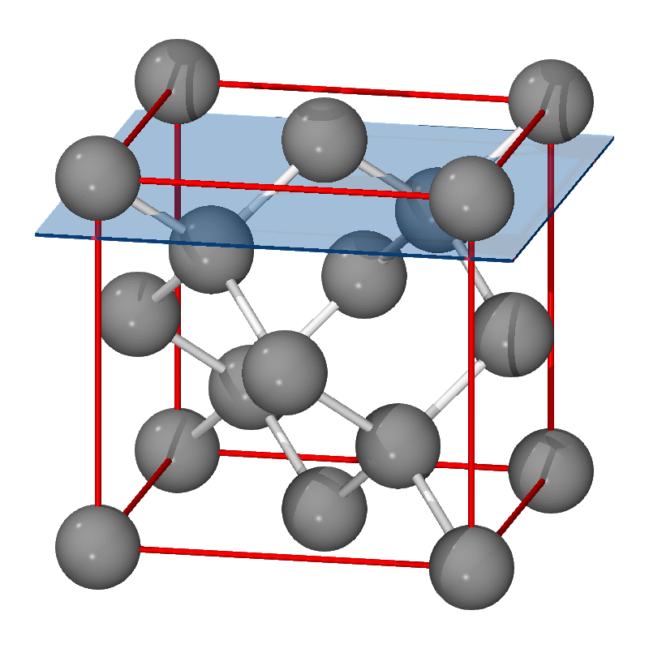
金刚石滑移面

Slide 4
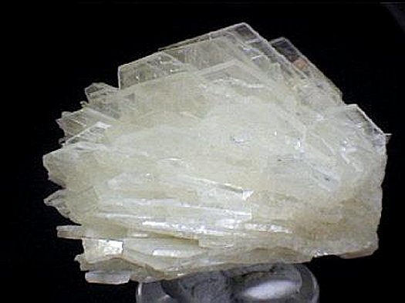
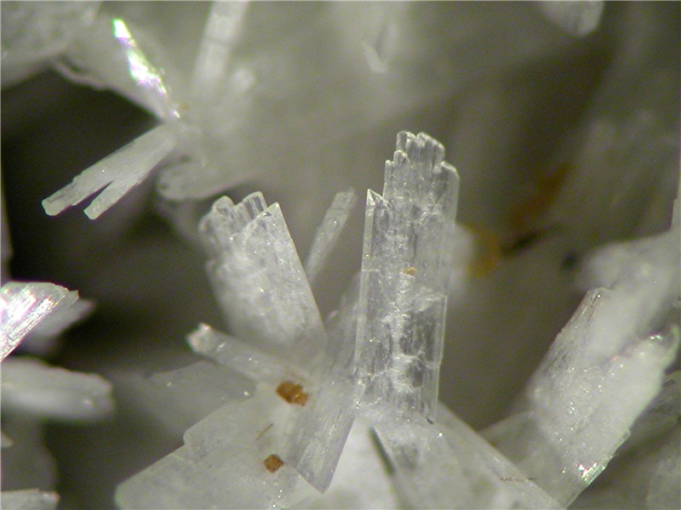
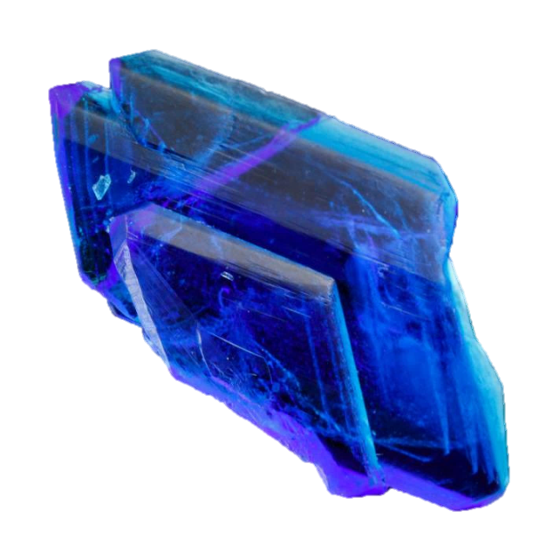
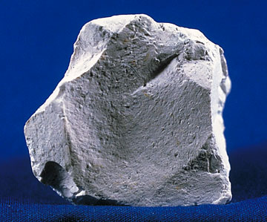
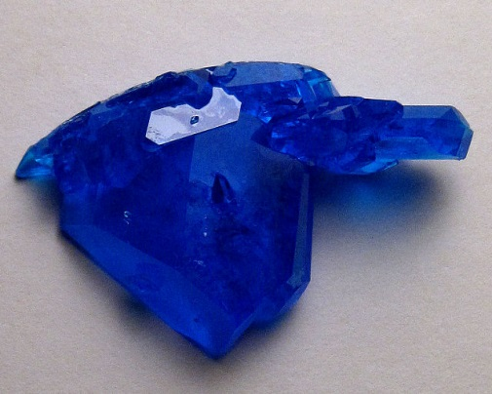
钠长石
胆矾
三斜晶系
高岭石

Slide 5
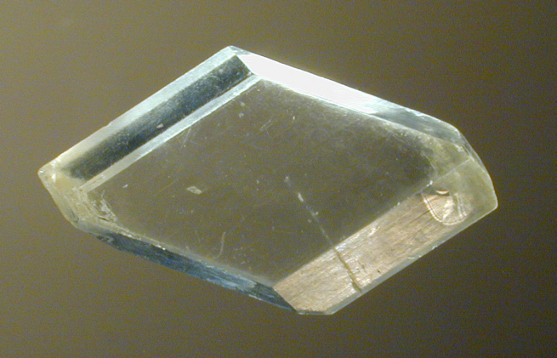
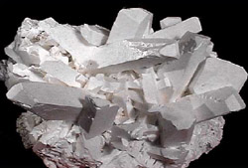
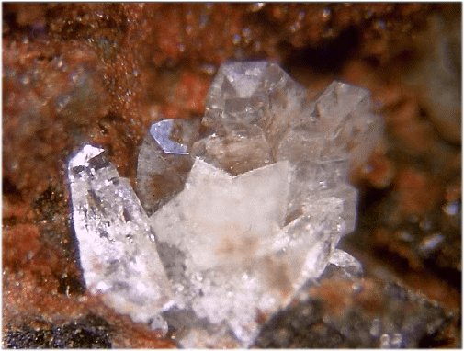
石膏
硼砂
斜晶石
单斜晶系

Slide 6
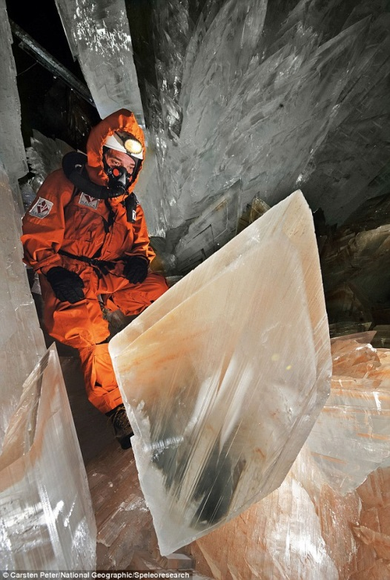
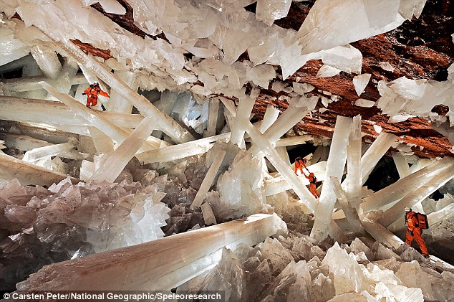
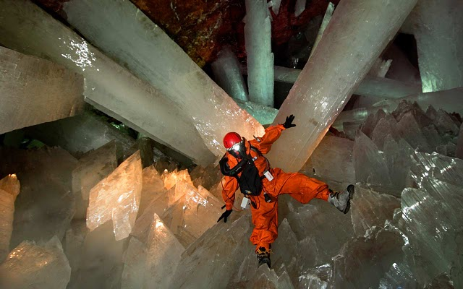
Crystal Palace
In the Naica mines of northern Mexico, near the city of Chihuahua, an underground city of giant crystals form a truly unreal landscape. Hundreds of thousands of years old, the giant selenite crystals existed for millennia in a completely closed environment; a true geode, the Naica Cuevo de los Cristales is completely covered in the transparent “macrocrystals,” some of which have grown up to 12 meters in length. Discovered in 2000 by two brothers working in the Naica silver and gold mine 1,000 feet below the surface of the earth, the crystals in this cave are some of the largest ever to be found.
For hundreds of thousands of years, groundwater saturated with calcium sulfate filtered through the many caves at Naica, warmed by heat from the magma below. As the magma cooled, water temperature inside the cave eventually stabilized at about 136°F. At this temperature minerals in the water began converting to selenite, molecules of which were laid down like tiny bricks to form crystals.

Slide 7
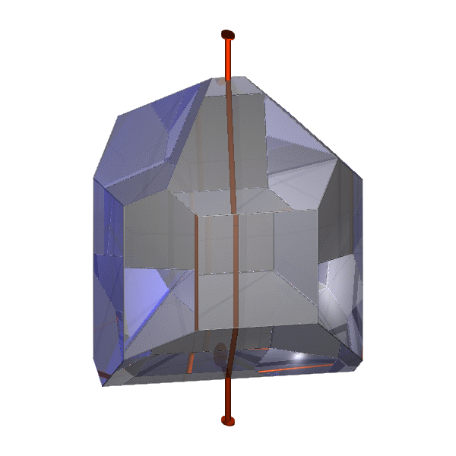
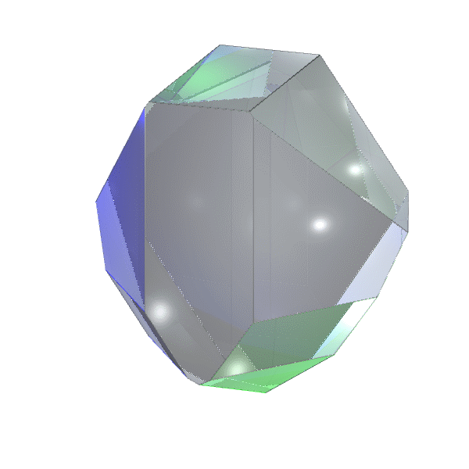
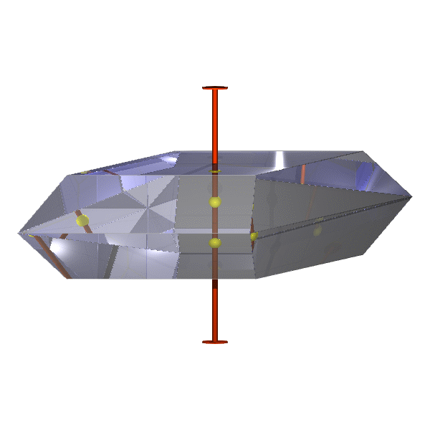
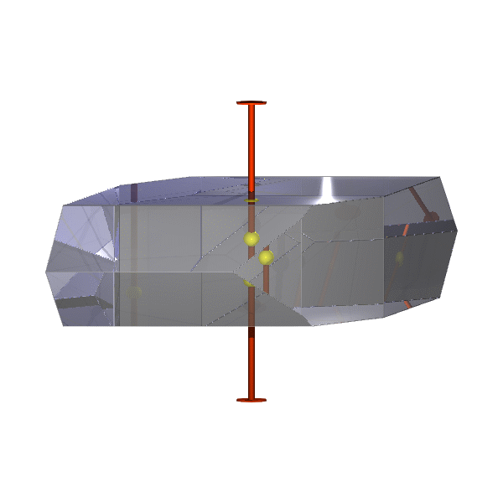
C₂
C_{s}
酒石酸
四硫酸钾
石膏
C_{2h}
正长石

Slide 8
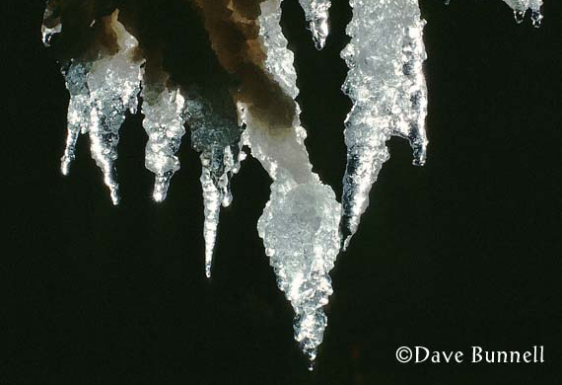
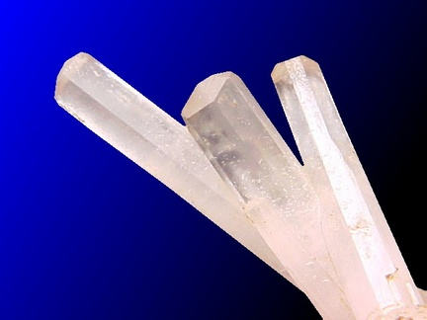
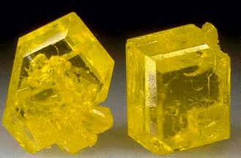
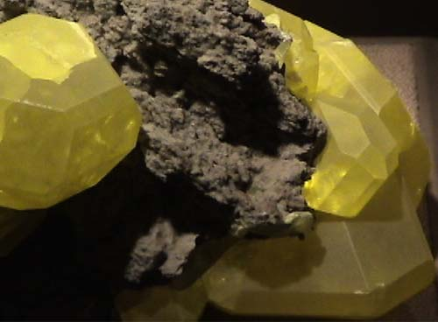
泻利盐
钠沸石
硫黄(S)
正交晶系

Slide 9
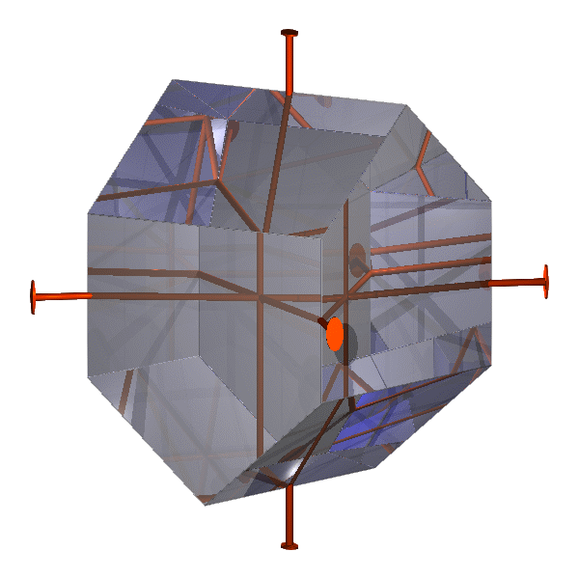
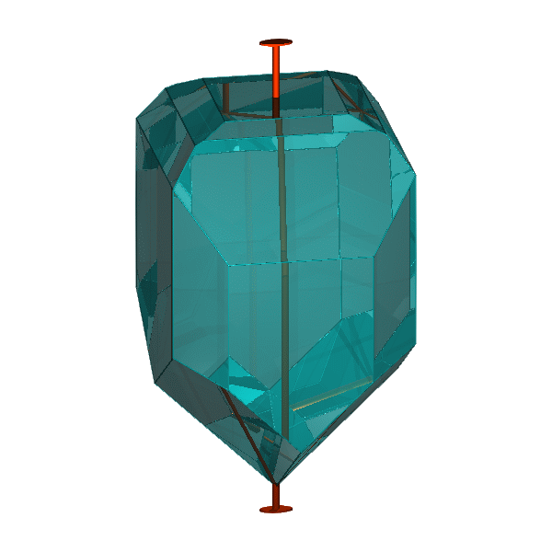
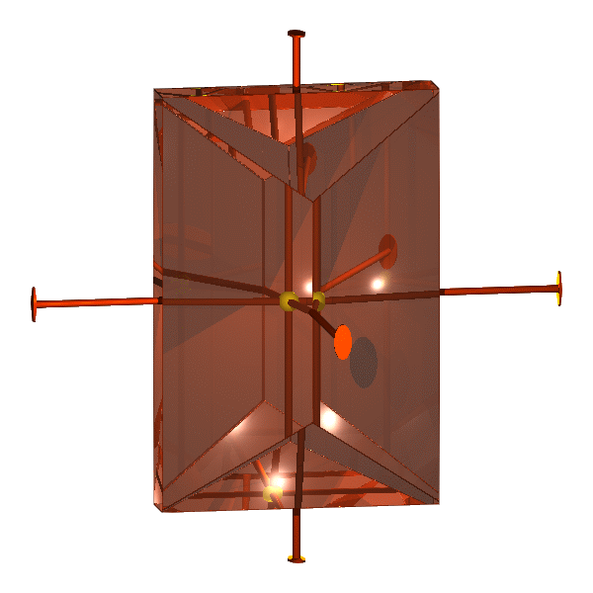
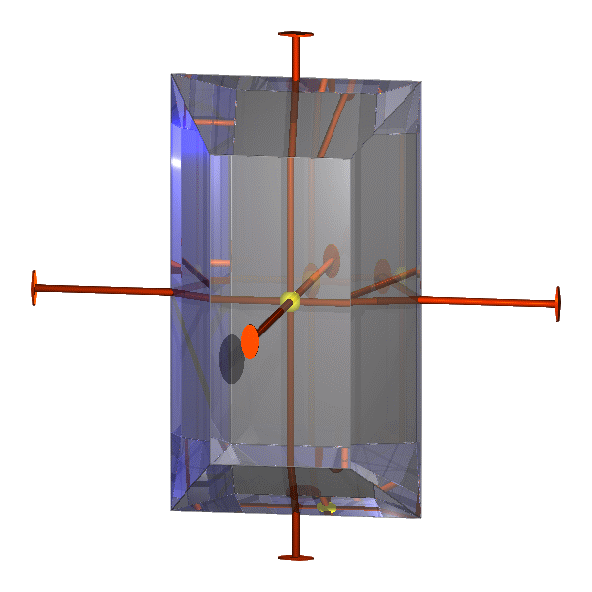
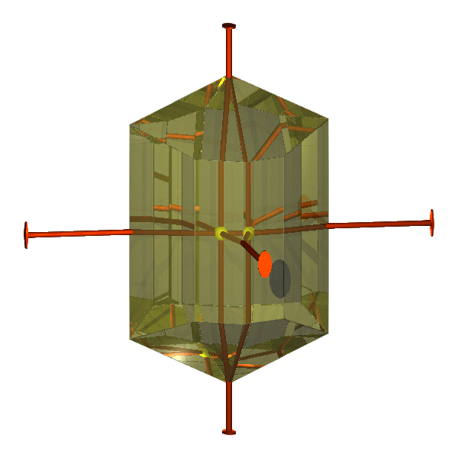
D₂
C_{2v}
泻利盐
异极矿
十字石
霰石
黄玉
D_{2h}

Slide 10
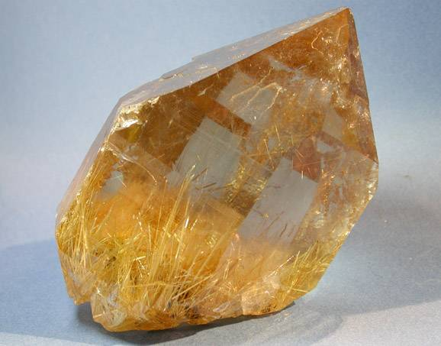
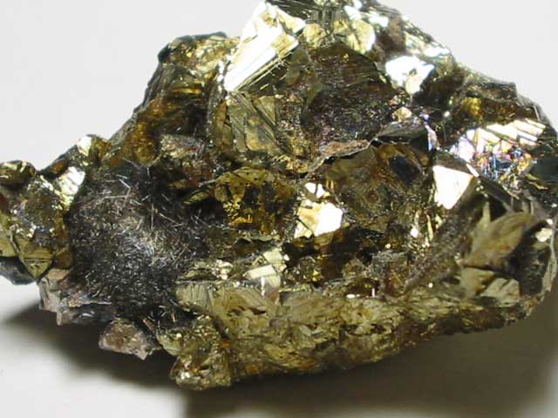
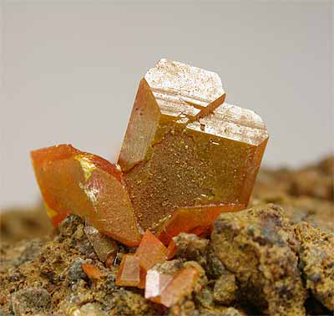
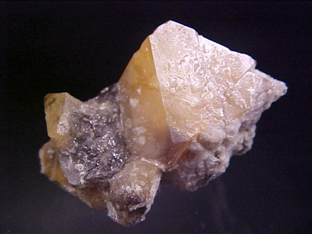
TiO₂(金红石)
CuFeS₂(黄铜矿)
四方晶系
钼铅矿
白钨矿

Slide 11
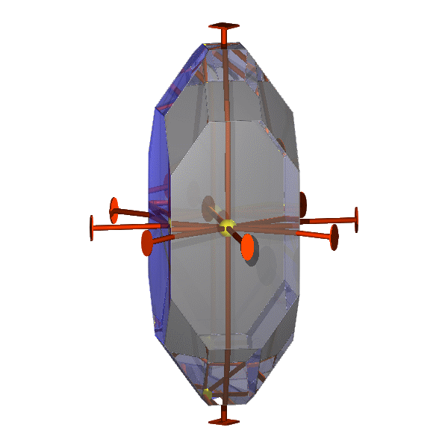
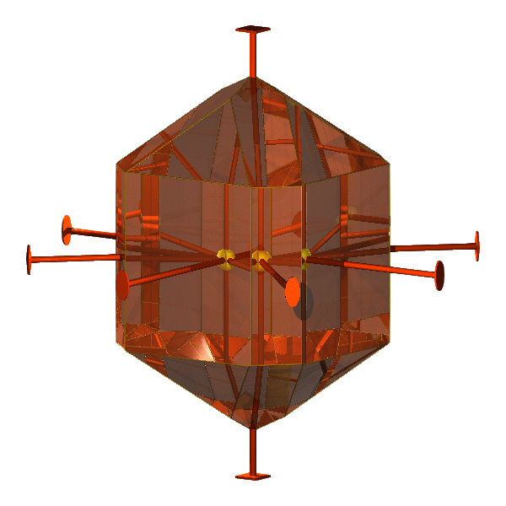
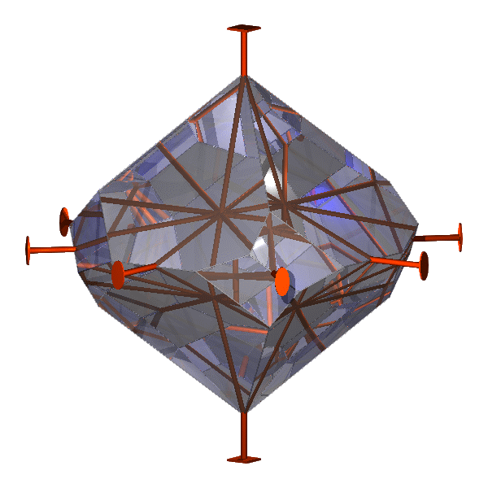
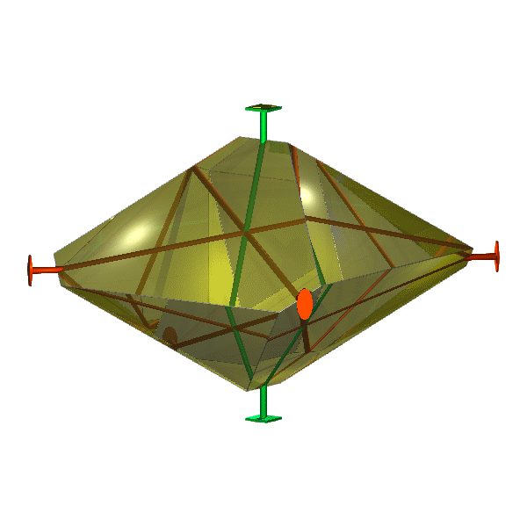
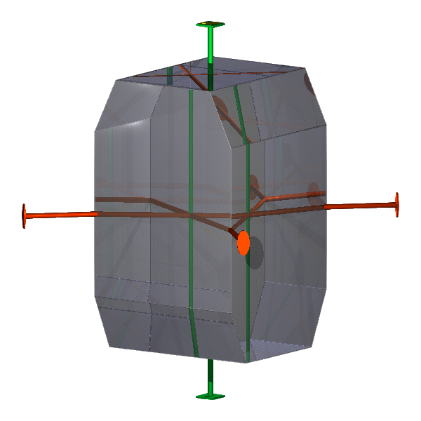
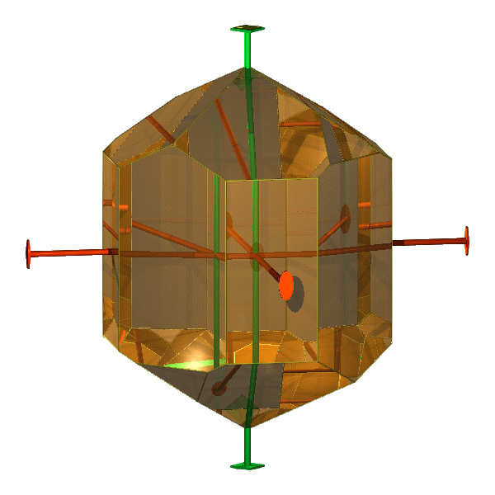
D₄
D_{4h}
甘汞
金红石
三氯乙酸钾
D_{2d}
黄铜矿
尿素

Slide 12
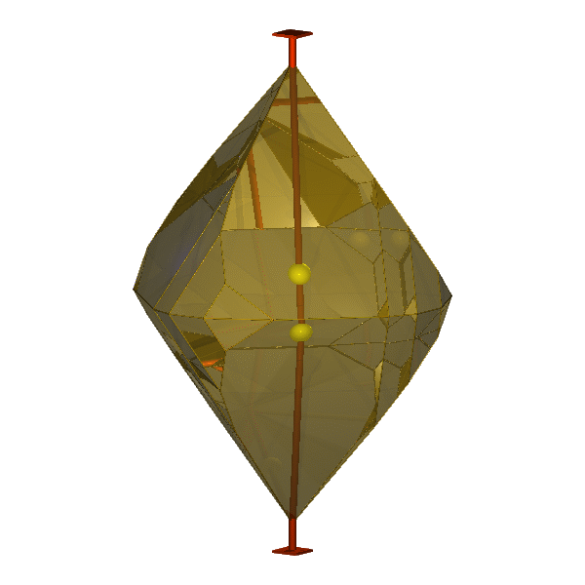
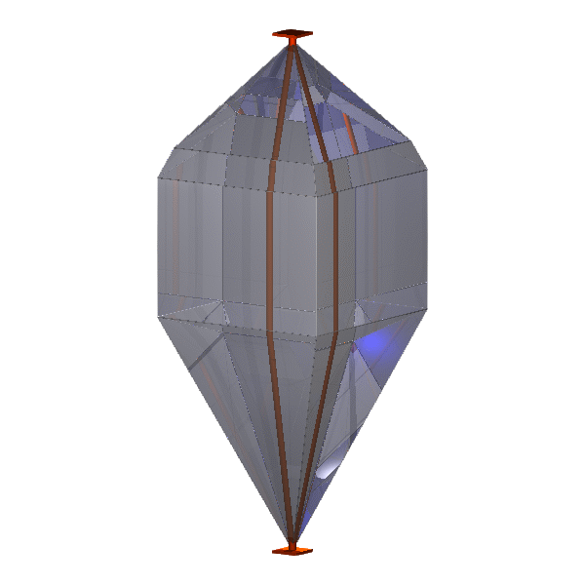
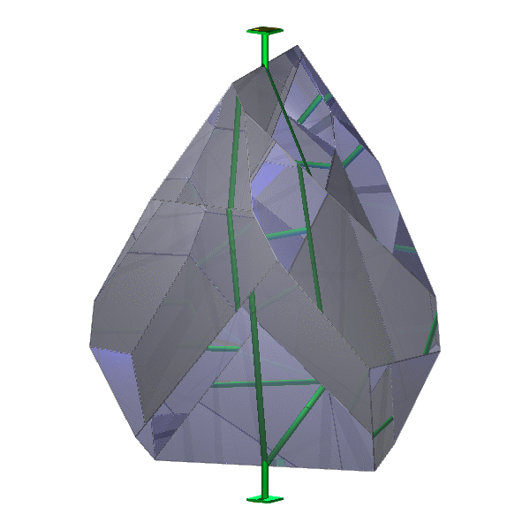
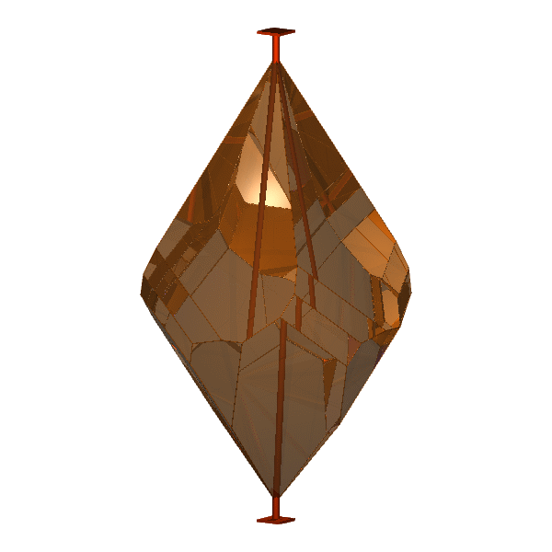
琥珀酸
碘亚氮
C_{4h}
白钨矿
C_{4v}
S₄
C₄
Co₄B₂As₂O₁₂·4H₂O
彩钼铅矿

Slide 13
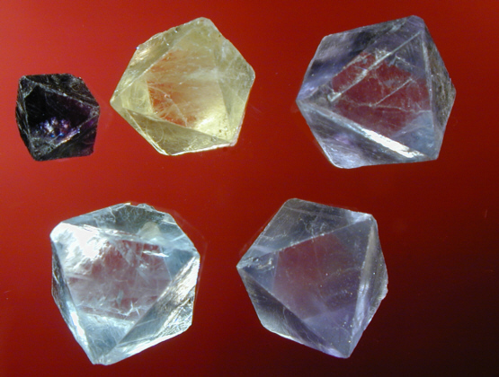
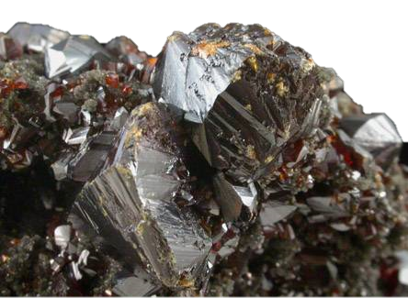
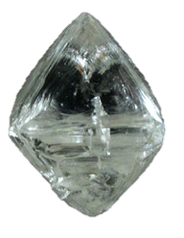
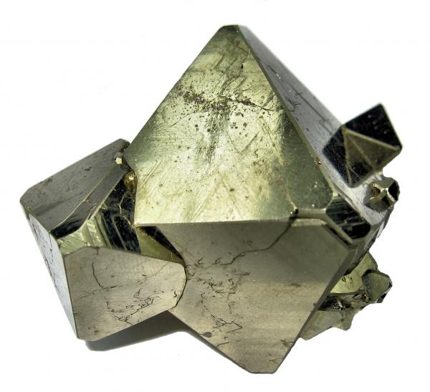
CaF₂(萤石) O_{h}
ZnS(闪锌矿) T_{d}
FeS₂ T_{h}
立方晶系
钻石

Slide 14
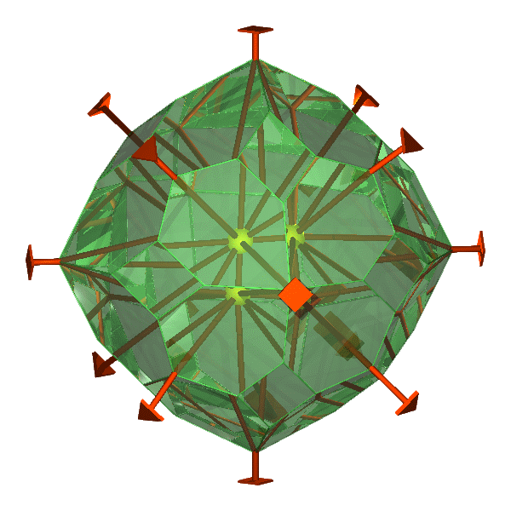
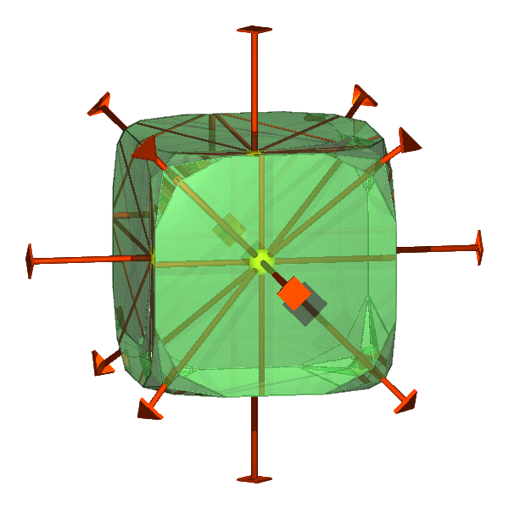
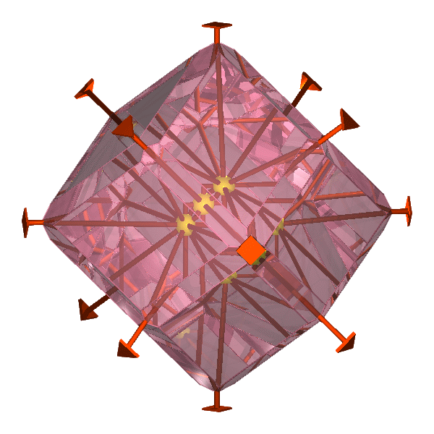
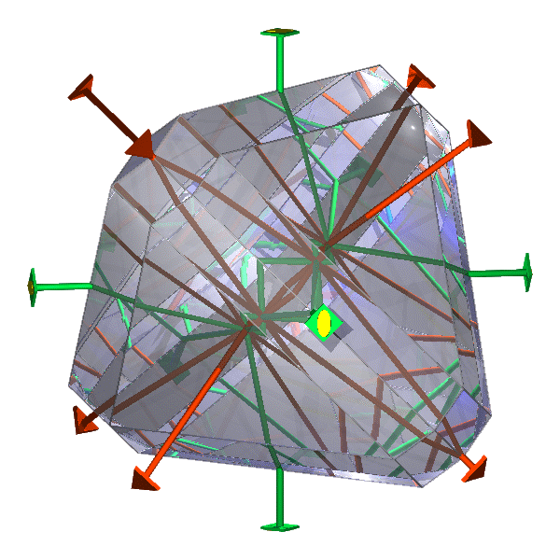
O_{h}
萤石
钙铝榴石
T_{d}
黝铜矿

Slide 15




O
T
赤铜矿
氯酸钠
T_{h}
黄铁矿

Slide 16






冰
六方晶系
石墨
磷灰石
β-石英(SiO₂)

Slide 17





辉钼矿
红锌矿
绿宝石
蓝锥矿(硅酸钡钛矿)
霞石
六方晶系

Slide 18



C₆
C_{3h}
酒石酸锑锶
磷酸氢二银
C_{6h}
磷灰石

Slide 19





C_{6v}
红锌矿
D₆
D_{3h}
矽酸钡钛矿
β-石英
绿柱石
D_{6h}
磁黄铁矿

Slide 20





CaCO₃(方解石)
电气石
白云石
刚玉
辰砂
三方晶系

Slide 21




过碘酸钠
似晶石
C₃
C_{3i}
辰砂
D₃
α-石英

Slide 22




C_{3v}
电气石
D_{3d}
刚玉
方解石
赤铁矿

